Slide 1


Slide 2


Predicting Fuel Efficiency: A Competitive Advantage
In the automotive industry, fuel efficiency is a crucial factor influencing consumer choices and environmental impact. This presentation explores the development of a predictive model that leverages machine learning to accurately predict fuel efficiency based on various automotive attributes, enabling manufacturers to optimize designs and gain a competitive edge.
By Indhu reddy

Slide 3
Importance of Fuel
Efficiency Optimization
1
Reduced Fuel Costs
2
Environmental Sustainability
Improved fuel efficiency directly translates into lower operating costs for consumers, enhancing vehicle affordability and increasing market appeal.
By minimizing fuel consumption, manufacturers contribute to reducing carbon emissions and promoting environmentally responsible transportation.
3
Competitive Edge
4
Regulatory Compliance
Offering vehicles with superior fuel efficiency provides a key differentiator in the market, attracting environmentally conscious consumers and boosting brand reputation.
Meeting increasingly stringent fuel economy regulations is essential for manufacturers to avoid penalties and ensure market access.

Slide 4
Automotive Attributes Impacting Fuel Efficiency
Engine Type & Size
Aerodynamic Design
Vehicle Weight & Mass
The type and size of the engine significantly influence fuel consumption. Smaller, more efficient engines generally consume less fuel.
Streamlined body shapes and reduced drag coefficients contribute to improved fuel efficiency by minimizing air resistance.
Heavier vehicles require more energy to move, leading to higher fuel consumption. Lightweight materials and design optimizations can enhance efficiency.

Slide 5
Machine Learning Approach for Predictive Modeling
Data Collection & Preparation
1
Gathering a comprehensive dataset of automotive attributes and corresponding fuel efficiency measurements is essential for model training.
2
Feature Engineering & Selection
Identifying relevant features from the collected data and applying appropriate transformations to optimize model performance is crucial.
Model Training & Validation
3
Using a machine learning algorithm, the model is trained on the prepared data, and its performance is evaluated on unseen data to assess accuracy and generalization ability.
4
Model Deployment & Monitoring
Once validated, the trained model can be deployed for real-time predictions, and its performance needs to be monitored and refined over time to ensure accuracy and relevance.

Slide 6
Data Collection & Preparation
Understanding the data set
Dataset Overview
Data cleaning
Load Data
check the columns
checking the datatypes
Checking Basic Statistical Details
The dataset contains various automotive attributes, including:
mpg (Miles per gallon)
cylinders
displacement
horsepower
weight
acceleration
model year
origin
car name
Checking Null Values and duplicates
Replacing Null Values with mean value after deep analyzing

Slide 7
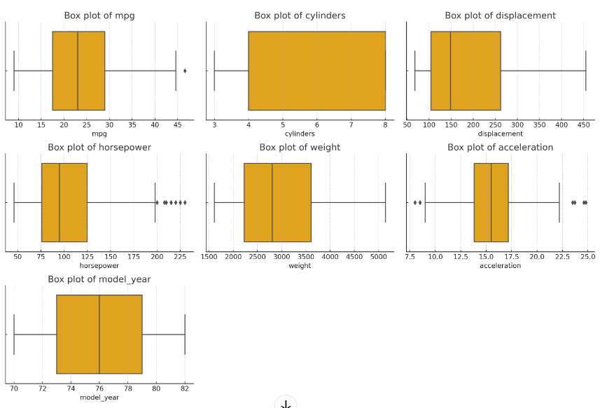
Feature Engineering & Selection
Exploratory Data Analysis (EDA)
Exploratory Data Analysis (EDA) aims to enhance understanding of data trends without
complex models, often revealing insights through
simple visualizations and statistical techniques to inform subsequent analysis.
Detect outliers using Box Plots.
Outliers are visible in columns like mpg, horsepower, and weight.
These outliers could impact model performance and may need to be handled.

Slide 8
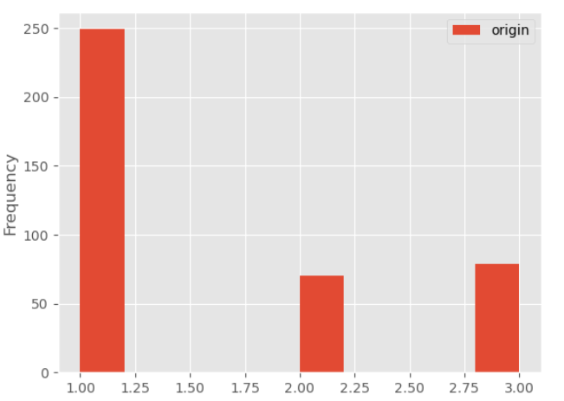
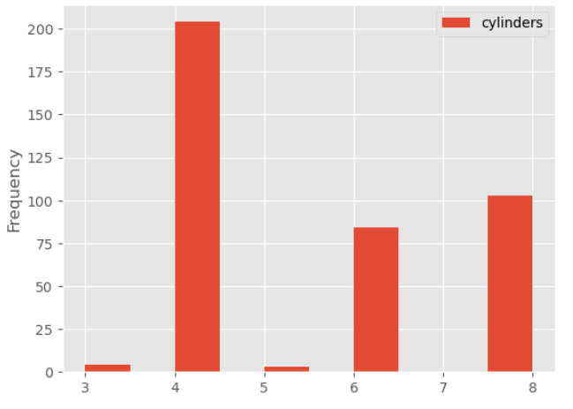
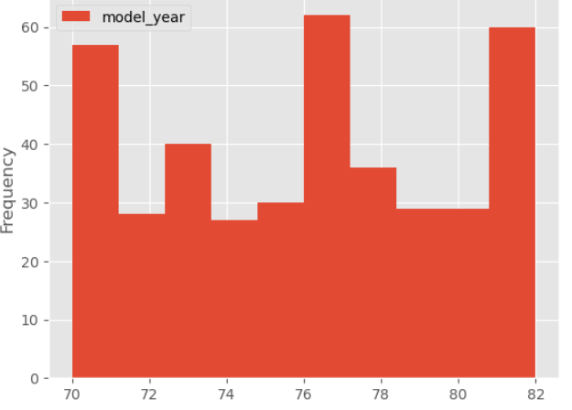
Exploratory Data Analysis (EDA)
Checking Distribution of Variables using Histogram Plot
Insights from Exploratory Data Analysis
1. Origin Distribution : The graph shows that the majority of vehicles belong to Origin 1.
2. Cylinder Count Distribution : The graph indicates that the majority of vehicles have 4 cylinders.
3. Manufacturing Year Distribution : The graph reveals that the majority of vehicles
were manufactured between 1976 and 1977.

Slide 9
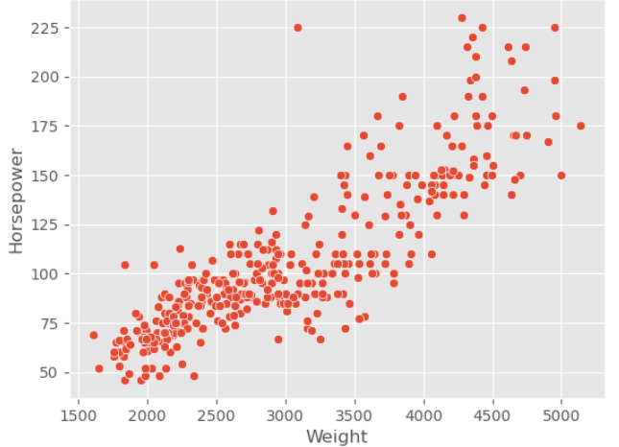
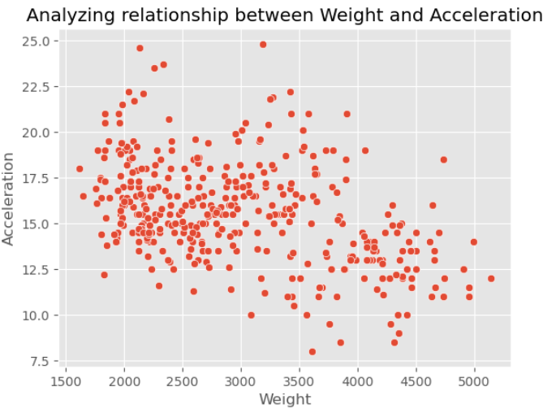
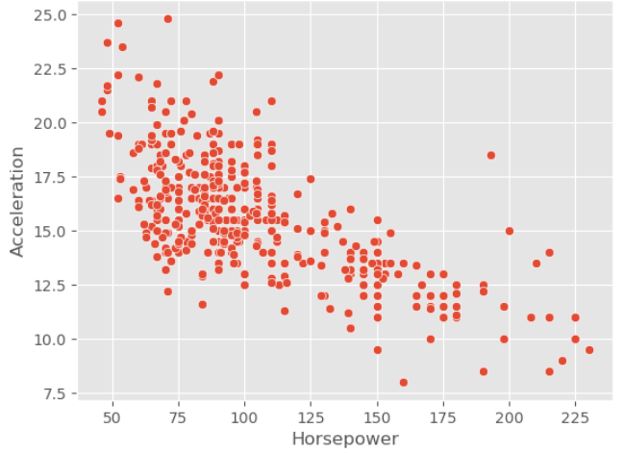
Exploratory Data Analysis (EDA)
Analyzing Relationship Between Independent Variables Using Scatter Plot
Analyzing Relationships in the Dataset
Weight vs. Horsepower : The plot suggests a positive correlation between weight and
horsepower, indicating that as horsepower increases, the weight of the vehicle tends to
increase as well.
Weight vs. Acceleration : The distribution reveals an inverse relationship between weight
and acceleration, implying that as the weight of the vehicle increases, its acceleration
tends to decrease.
Horsepower vs. Acceleration : The data points to an inverse correlation between horsepower
and acceleration, suggesting that as the horsepower of the vehicle increases, its acceleration
tends to decrease.

Slide 10
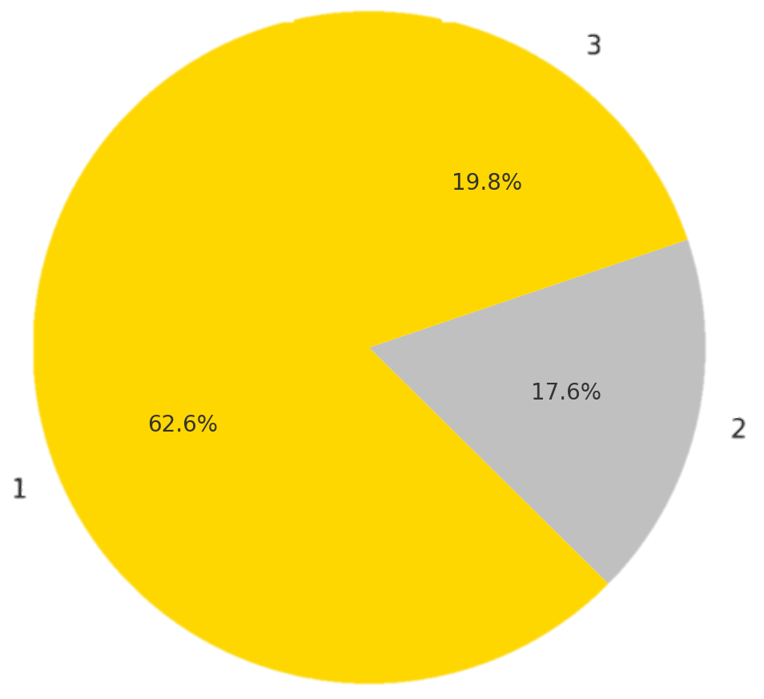
Exploratory Data Analysis (EDA)
Pie chart showing distribution of Vehicles over different Origin

Slide 11
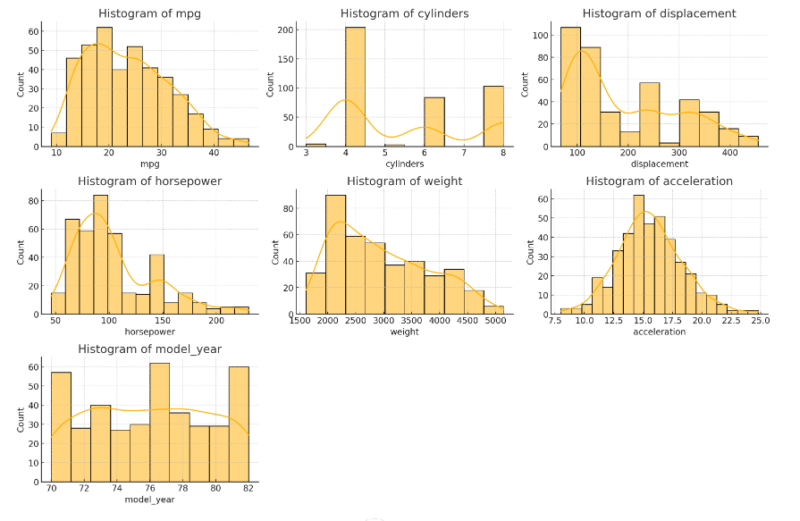
Exploratory Data Analysis (EDA)
Analyzing distribution of columns

Slide 12
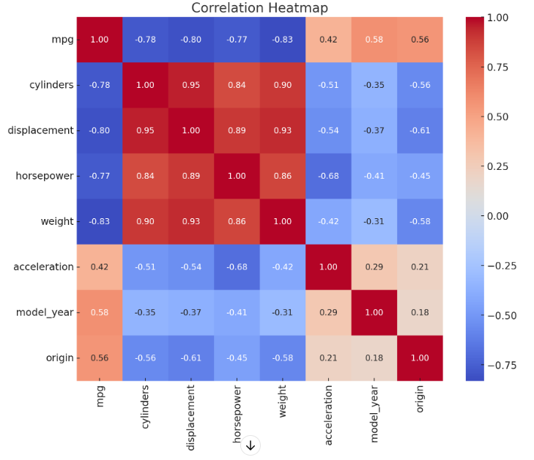
Exploratory Data Analysis (EDA)
Plotting Heatmap to Understand Relationship between numerical Variables
After understanding the data removing the unwanted columns like
1. model year, 2.origin for better outcome

Slide 13
Preprocessing - Train-Test Split
Preprocessing raw data into a format suitable for computer and machine learning algorithms is a crucial step in the data analysis process that significantly impacts the precision and efficiency of subsequent models.
Define Features and Target Variable:
Features (X): All columns except mpg and car_name.
Target (y): The mpg column.
Split Data:
Use train_test_split to split the dataset into training and testing sets.
Recommended split ratio is 80% training and 20% testing.

Slide 14
Model Training :Experimentation with Various ML Models
Model
Description
Advantages
Disadvantages
Linear Regression
Predicts fuel efficiency based on a linear relationship with automotive attributes.
Simple and interpretable.
May not capture complex relationships.
Decision Tree
Creates a tree-like structure to classify fuel efficiency based on attribute values.
Handles non-linear relationships.
Can overfit to training data.
Random Forest
Ensembles multiple decision trees to improve prediction accuracy and reduce overfitting.
High accuracy and robust to outliers.
Can be computationally expensive.
Rigid Regression
A type of linear regression that adds a penalty term to the cost function to prevent overfitting.
Handles multicollinearity effectively. Provides more stable and reliable predictions.
Depends on the choice of regularization parameter.
Interpretation of coefficients is complex.
Lasso Regression
adds a penalty term to the cost function, using the L1 norm, leading to sparse solutions and automatic feature selection.
Performs feature selection.
Provides interpretable models.
May not perform well with more predictors than observations or highly correlated predictors.

Slide 15




Evaluating Model Performance and
Accuracy
Metrics Selection
Appropriate metrics like R-squared, Mean Squared Error (MSE), and
Root Mean Squared Error (RMSE) are used to evaluate model accuracy
and performance.
Model Comparison & Selection
The performance of different models is compared using these metrics
to identify the most accurate and reliable model for predicting fuel
efficiency.
Hyperparameter Tuning
Fine-tuning the model's parameters to optimize performance and
achieve the best possible prediction accuracy is essential.

Slide 16
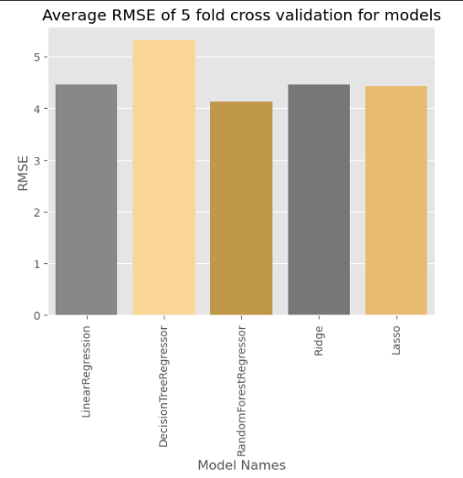
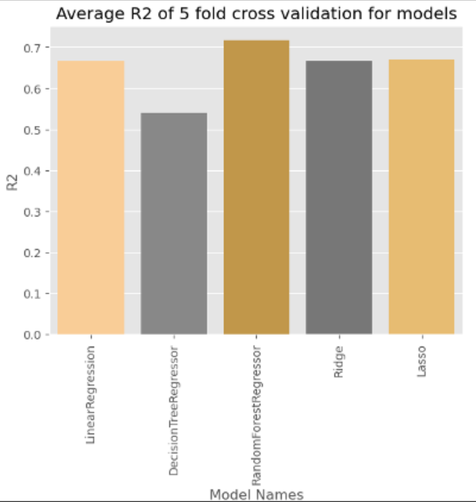
Model Validation :Model Evaluation & Selection
Insights from Model Evaluation Metrics
1. RMSE (Root Mean Squared Error) : The bar plot indicates that the RandomForestRegressor model has the minimum RMSE among the evaluated models, suggesting it has the lowest average error during the 5-fold cross-validation process.
2. R-squared (R2) Score : The bar plot shows that the RandomForestRegressor model has the maximum R2 score, meaning it explains the greatest proportion of the variance in the target variable using the available features. A higher R2 score implies the model is better at capturing the relationships between the features and the target.

Slide 17
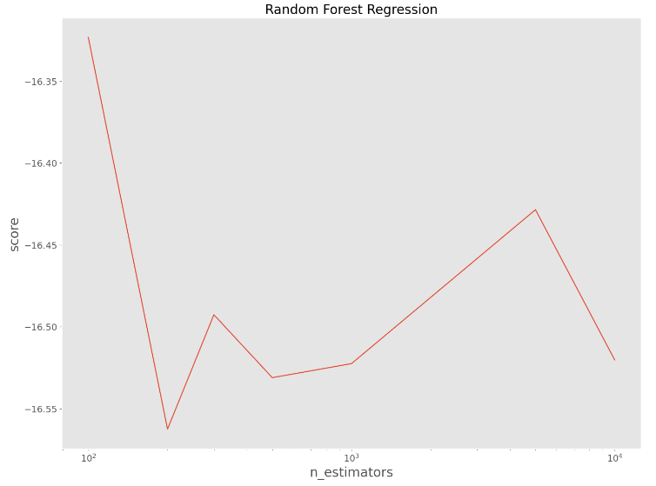
Hyperparameter tuning
1
Hyperparameter tuning is the process of identifying the optimal set of hyperparameter values for a learning algorithm, with the goal of maximizing the model's performance by minimizing a predefined loss function. This optimization step helps to produce better results with fewer errors when applying the tuned algorithm to any given data.
2
Saving Model Using Pickle Library

Slide 18

Model Deployment & Monitoring
1
Interface
2
Input & output Features
Developed an accessible interface using Gradio to allow users to input vehicle attributes and receive fuel efficiency predictions.
The interface is designed to be intuitive and easy to use, promoting wider adoption and usability.
Input:
The interface includes inputs for the following vehicle attributes:
cylinders, displacement, horsepower, weight, acceleration
Output:
Provides a text classification or prediction of the mpg (miles per gallon).

Slide 19




Conclusion and Business Benefits
Competitive Advantage
Environmental Responsibility
Predictive fuel efficiency modeling provides a powerful tool for manufacturers to develop vehicles with superior fuel economy, differentiating themselves in the market.
Predictive modeling enables manufacturers to develop more fuel-efficient vehicles, contributing to reduced emissions and environmental sustainability.
Reduced Costs
Innovation & Growth
By optimizing designs based on accurate fuel efficiency predictions, manufacturers can reduce production costs and enhance vehicle affordability.
Continuous model improvement and data analysis pave the way for innovation and breakthroughs in fuel efficiency technologies, driving future growth.

Slide 20
THANK YOU…..

